Slide 2
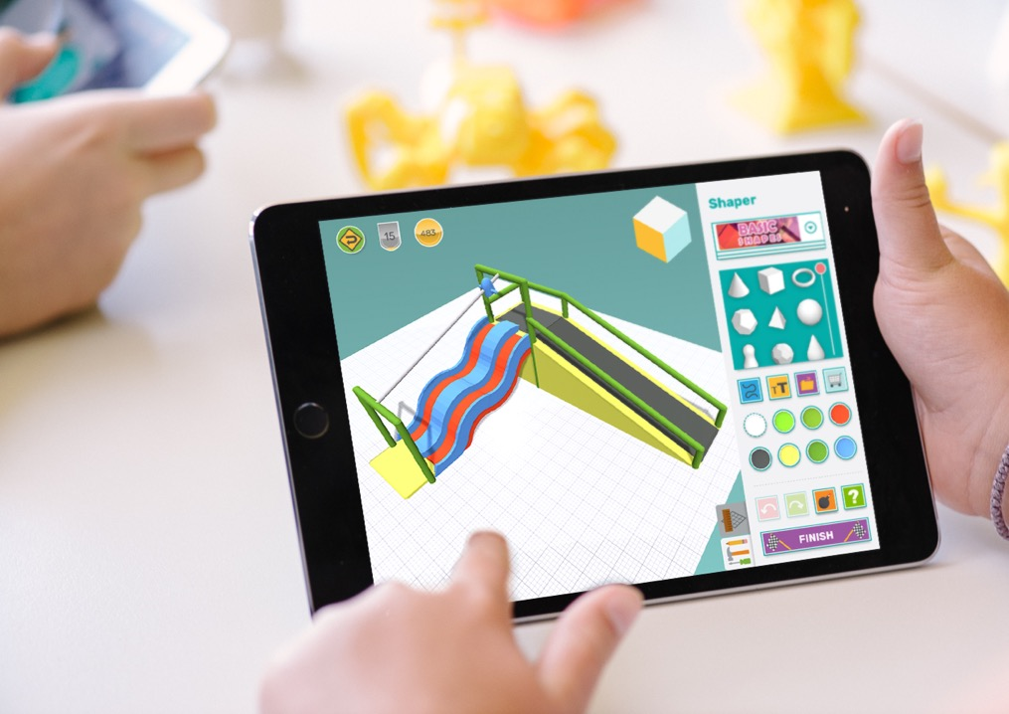
How we use Makers Empire
Students are using Makers Empire to develop their creative confidence and design thinking skills.

Slide 3
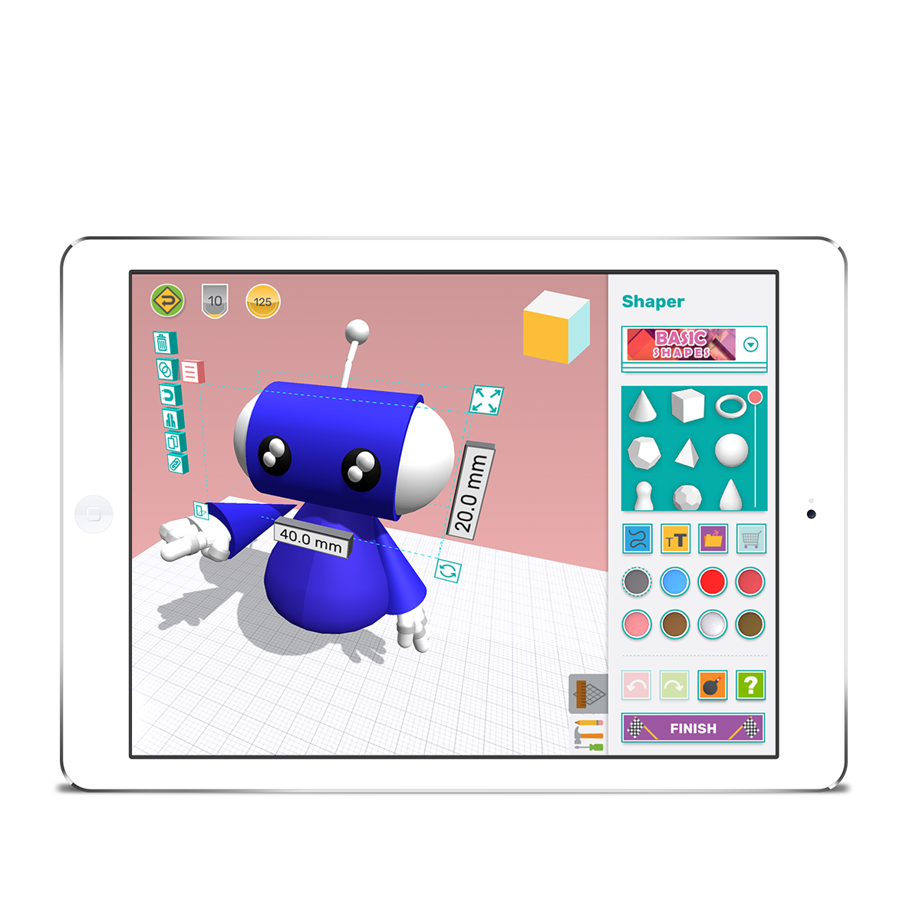
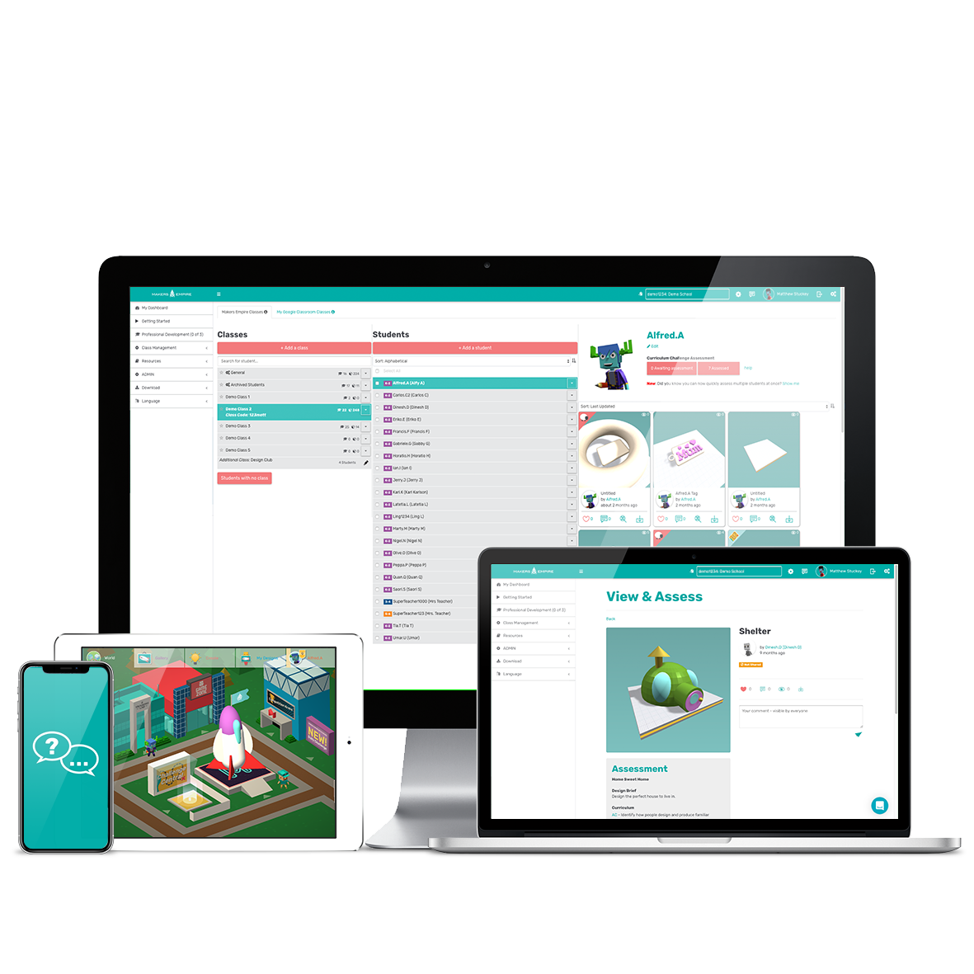
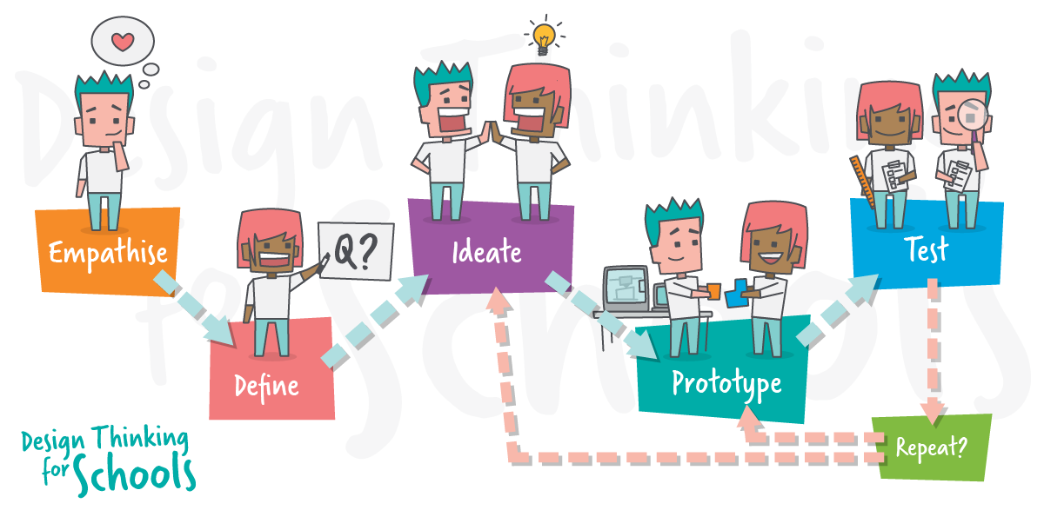
Makers Empire 3D Design & Technology program
Makers Empire 3D World’s most fun and easy to use 3D design software.
Teacher Dashboard
Planning, class management, assessment and reporting tools.
Learning by Design course
Custom professional development for school districts and education departments.
Researched Backed
Pedagogically Certified
Award Winner

Slide 4
Makers Empire 3D Design App
Built specifically for 5 to 12-year- old children for an immersive, fun and safe learning environment.
Children of all skill levels are motivated to create, learn, collaborate and share.
Progress and rewards are linked to effort, mastery of new skills and participation in positive interactions.

Slide 5
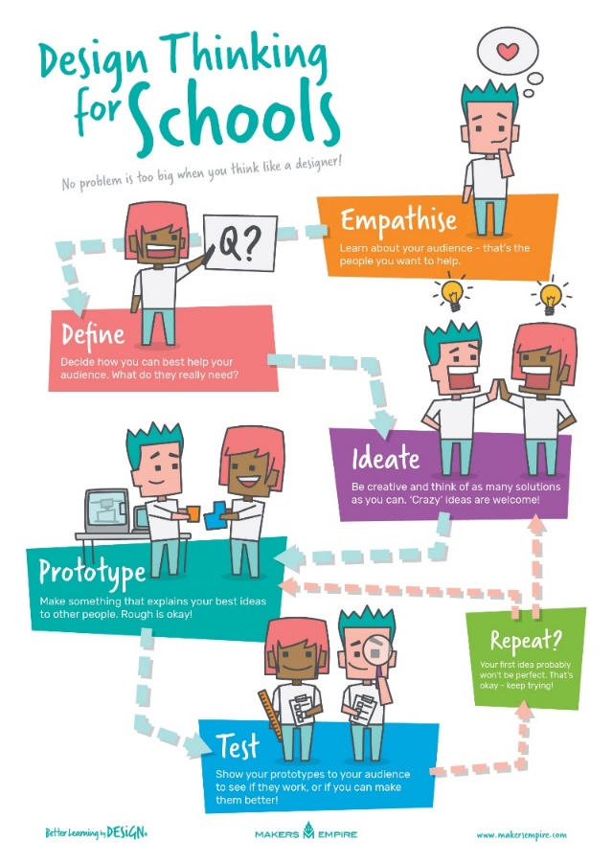
What is Design thinking?
“Design thinking is a way of thinking and working that helps us to define and solve problems. It is a non-linear, iterative and human-centred process that helps us to reframe problems as opportunities.”
Mandi Dimitriadis, Director of Learning, Makers Empire

Slide 6
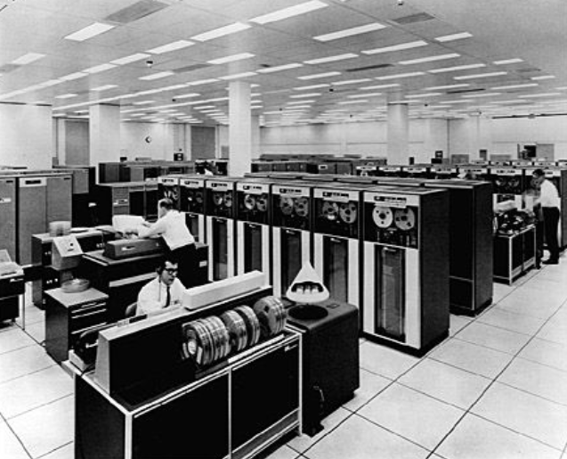
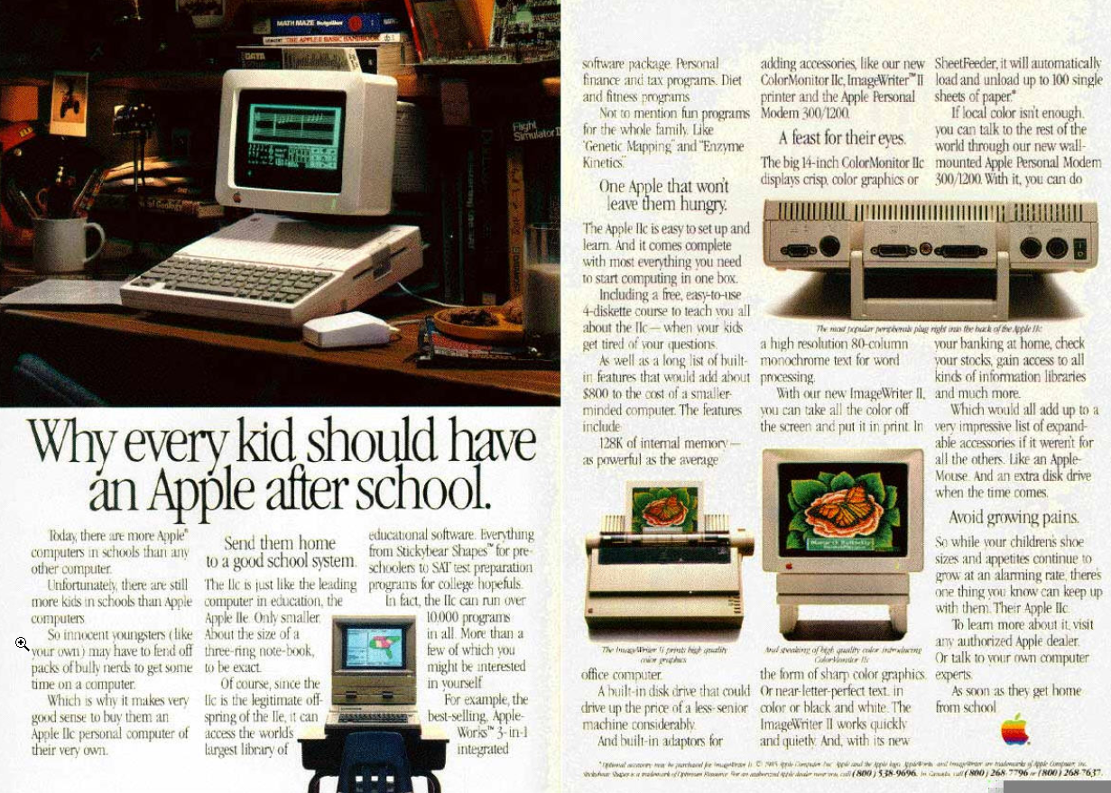
Why use 3D Design and 3D Printing to teach Design Thinking?
3D printing is one of the most important future manufacturing technologies.
Using 3D design and 3D printing for problem-solving activities allows students to bring their ideas and creation to life, providing a connection between abstract and concrete learning.
Like the transition from mainframe computers to personal computers in the 1980’s, the take up will be driven by easy-to-use software.

Slide 7
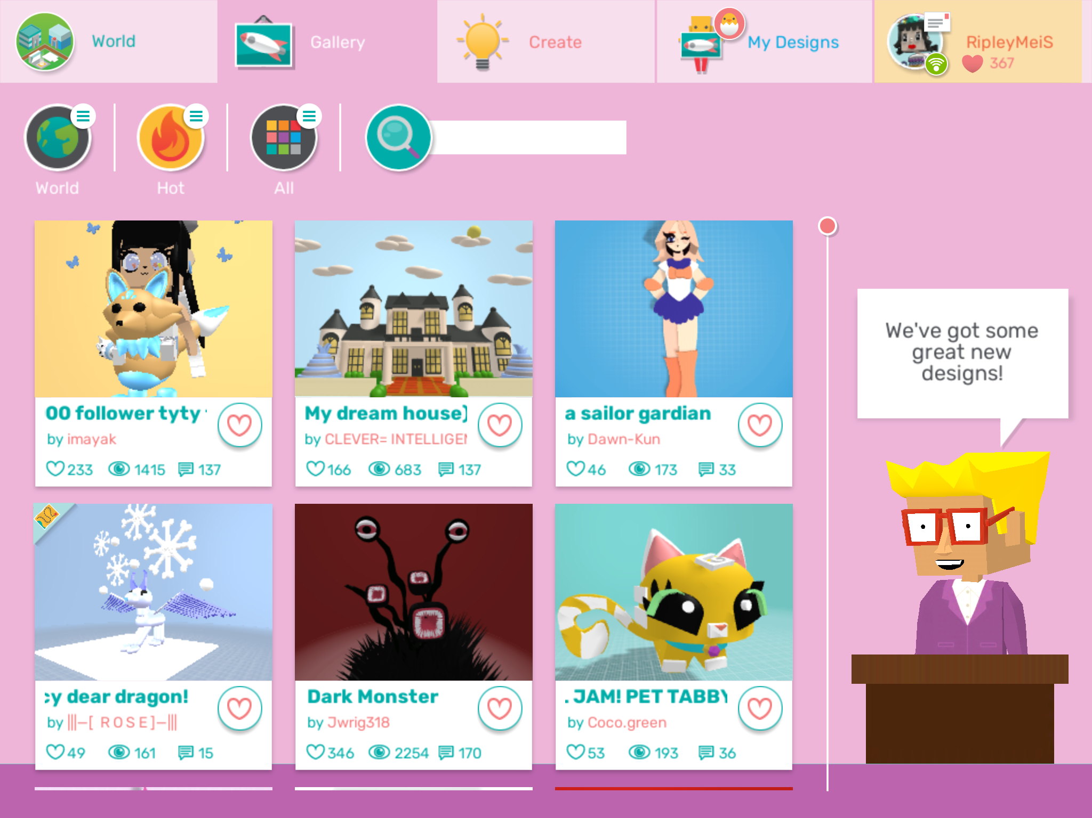
www.makersempire.com/designs

Slide 8
Check out some of our students designs…

Slide 9
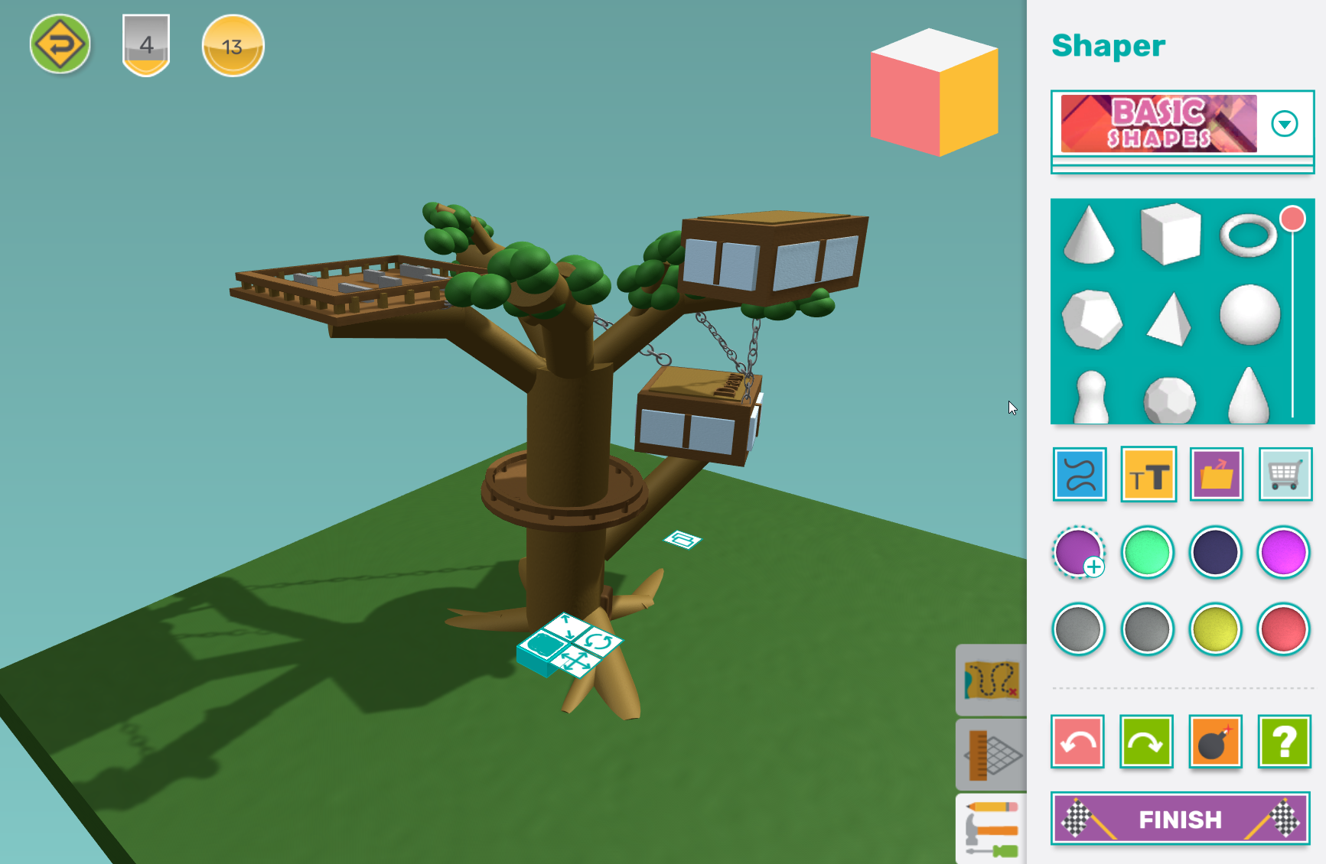

Slide 10
Check out the final 3D prints…

Slide 11
